Slide 1
EE 295
TechWriting-Engineering Ethics
Nov 5, 2019
Room E339
Tom Wrappe
EE Lecturer

Slide 2
-Slingshot Water Purification System
-Roboethics and AI Discussion
-Upcoming Deliverables
-Feedback Items

Slide 3
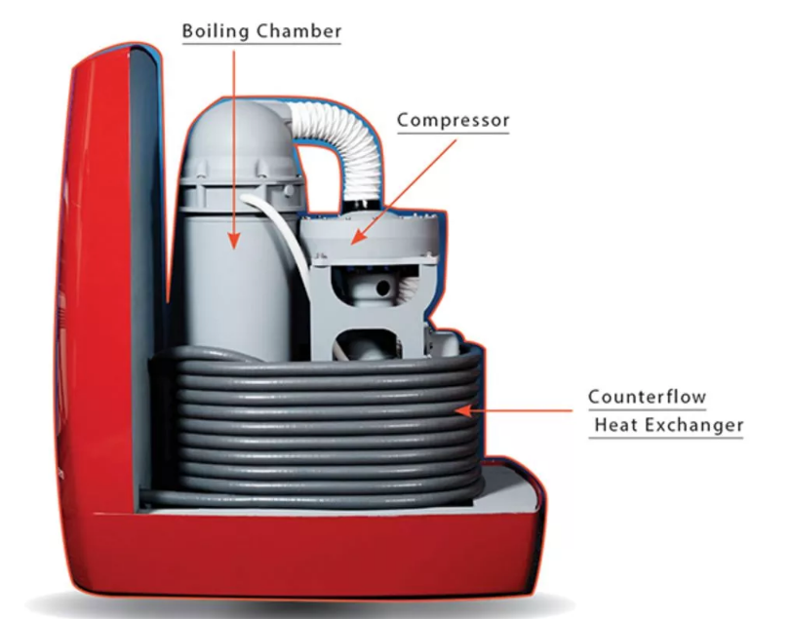
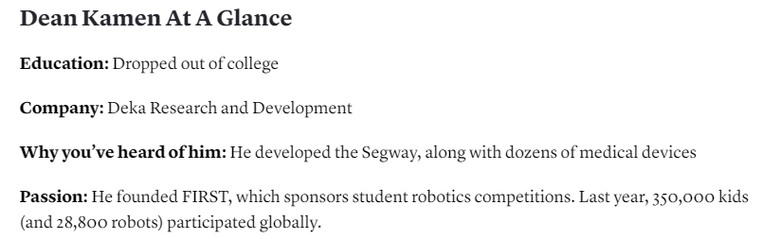
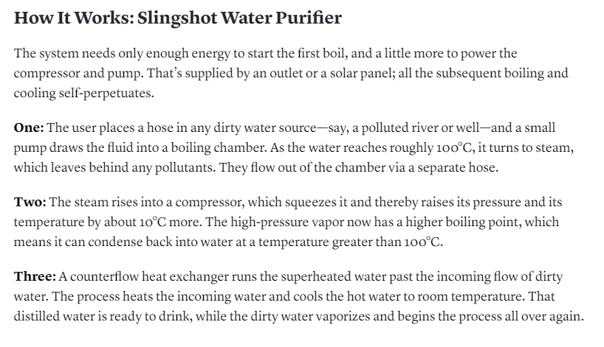
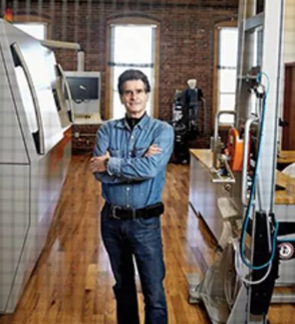

Slide 4
In Class Exercise #4: Focal Product Analysis
Dean Kamen Slingshot Water Purification
Write ½ to 1 page: Analysis of Slingshot from a Focal Product Perspective
------------------------------------------------------------------
IS Slingshot a Focal Product?
If so, Why and if not, Why not?
-------------------------------------------------------------------
1. Structure your work: Summary, Support, Conclusion
2. Support your work: Engagement, Enlivenment and Resonance
3. Clear, concise content (6pts): State position and support
4. Grammar per EE295 list (4pts): Paragraphs, no personal pronouns, etc
5. Underline all topic sentences

Slide 5
Robotics from Ethical Perspective

Slide 6
Intro to Roboethics
Personal Robots introduce a level of technology into our lives that goes well beyond the personal touch of previous devices
Roboethics is deserving of its own field
Categories
Safety
Privacy
Social Issues

Slide 7

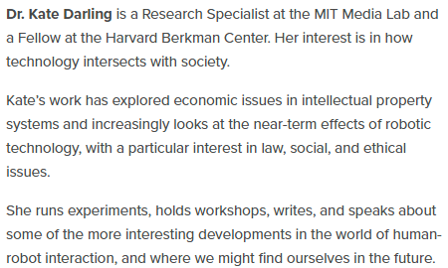
Dr. Kate Darling

Slide 8
Roboethics –Darling MIT
Roboethics

Slide 9
Roboethics is a Dense Subject
What are the ethical issues related to robots?
Based on Role
Military/ War Robots
Industrial Robots (Self-driving cars, trucks, drones)
Personal Robots
Social Issues
Personal Bonding Issues
How would Moriarty deal with this? What is a “Focal” Robot?
TO BE CONTINUED….

Slide 10
Top Ethical Issues Related to Robots
1. Unemployment. What is the problem and how to address?
2. Inequality. How do we redistribute wealth created?
3. Humanity. How do machines affect our behavior and interaction?
4. Artificial stupidity. How can we guard against mistakes?
5. Racist Robots. How do we eliminate AI bias?
6. Security. How do we keep AI safe from adversaries?
7. Evil Genies. How do we protect against unintended consequences?
8. Singularity. How do we stay in control of a complex intelligent system?
9. Robot Rights. How do we define the humane treatment of AI-driven robots?

Slide 11
Roboethics Discussion
Break into groups of 3 or 4
Each Group gets one of the 9 Roboethics Issue Areas
Discuss key aspects and Document as a group
Concise description of what the area is
How does the Issue Area affect the Robot “Focal Score”?
Ways to ethically address using our Engineering Ethics Analysis Background
As Engineers
By the Government
By an International Body

Slide 12
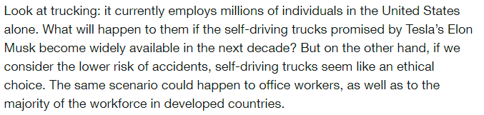
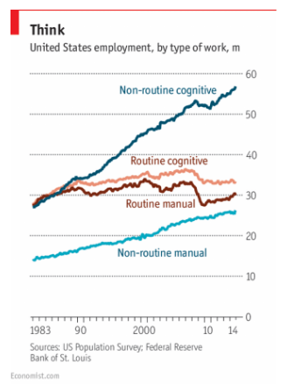
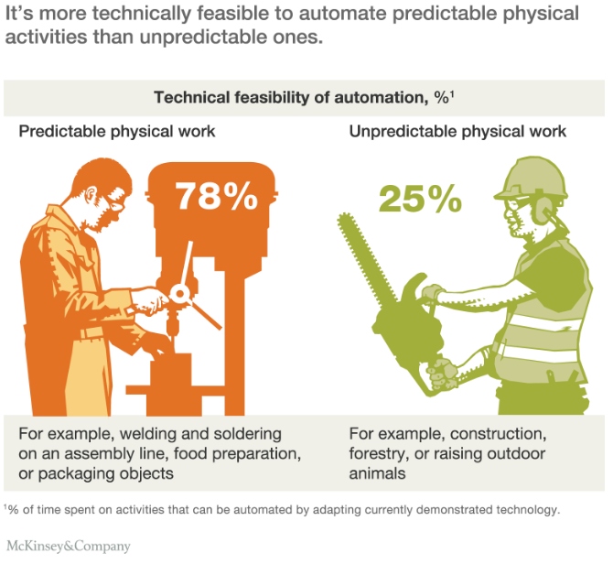
Unemployment. What happens when jobs end?

Slide 13
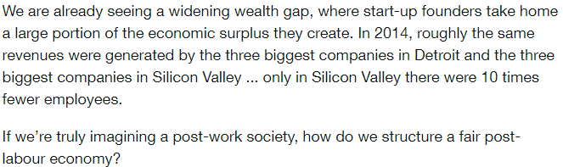
Inequality. How do we Redistribute wealth created?

Slide 14
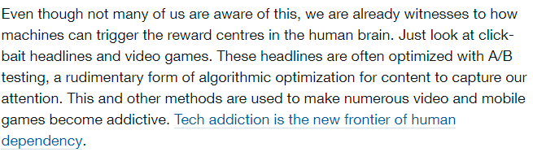
Humanity. How do machines affect our behaviour and interaction?

Slide 15
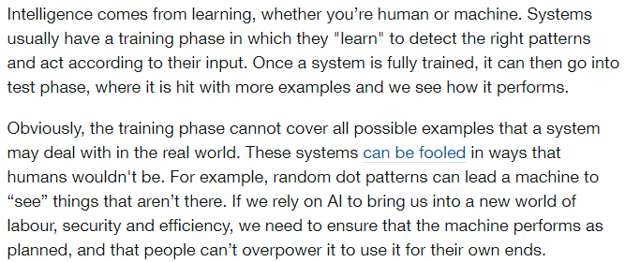
Artificial stupidity. How can we guard against mistakes?

Slide 16
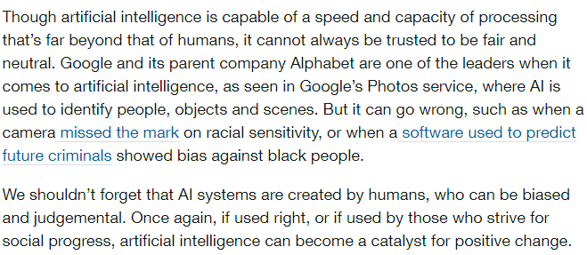
Racist robots. How do we eliminate AI bias?

Slide 17
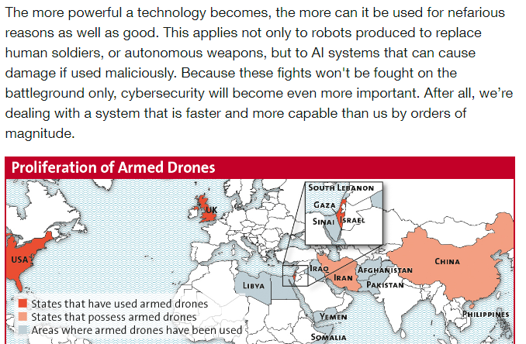
Security. How do we keep AI safe from adversaries?

Slide 18
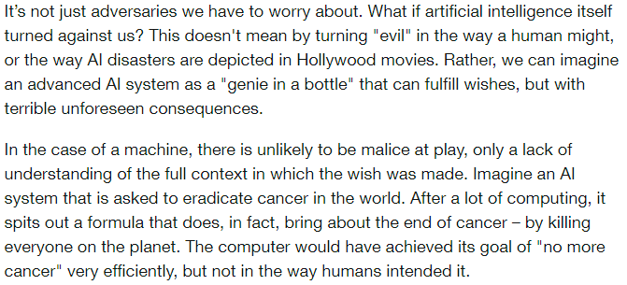
Evil Genies. How do we protect against unintended consequences?

Slide 19
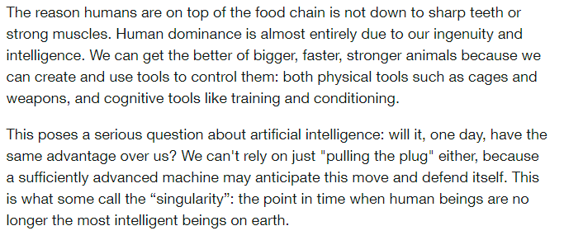
Singularity. How do we stay in control of a complex intelligent system?

Slide 20
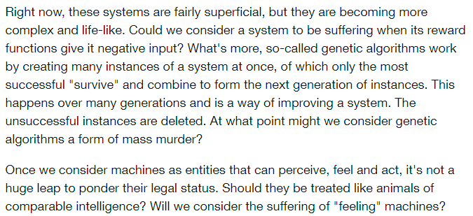
Robot rights. How do we define the humane treatment of AI

Slide 21
Semester Major Items…..(subject to modification)
 | Mid Term | Resume | Final Paper | Final Presentation (slides )
Topic Paragraph | 9.5.19
Topic Proposed | 9.12.19 |  | 10.3.19
Topic Final | 9.19.19 |  | 10.10.19
Outline/ Abstract | 9.26.19 |  | 10.31.19
Research | 10.1.19 | 10.24.19 (Class) | 10.15.19
Draft Complete | 10.13.19 ** |  | 11.10.19** | 11.19.19
Final Submit | 10.25.19 ** | 11.14.19 | 11.26.19 | 12.3.19
Final Presentation | NA | NA | NA | 12.17.19 (Sect 1) 12.12.19 (Sect 2)

Slide 22
Grading and Extra Credit
Given extra credit (EC) exercises, you may see over 100% for the In Class Assignments
This is great, but understand that EC only applies to the identified grading category
In Class EC will be applied only until 100% is achieved for the category, and cannot be “carried over” to the overall grade
Example
Category | % of final | No EC Grade | With EC (unbound) | Corrected
In Class | 22.5 | 67/70 (21.54) | 77/70 (24.75) | 22.5
Out Class | 22.5 | 76/80 (21.37) | 21.37 | 21.37
Midterm | 15 | 12 | 12 | 12
Final | 30 | 26 | 26 | 26
Final Present | 10 | 8.5 | 8.5 | 8.5
Total | 100 | 89.41 | 92.62 | 90.37

Slide 23
Final Paper
-Research complete
-Abstract/Outline complete

Slide 24
Final Paper: Outline/Abstract due Oct 31
Submit an outline and an abstract For your final Paper using 1-2 pages
Expand on your topic selection
-”Fine tune” your topic
-Create outline based on the complete Product Proposal or Research Paper outline
-Prepare a summary with one or two paragraphs (not bullet items, full sentence-based paragraphs) that capture the key elements of each section
Summarize your market and technology research (previously 20 sources)
-Fill out a complete checklist per instructions as a condition of grading
3.Provide a “budget” totaling 7200 +/- words (15 pages) for your Final Paper (Extended Proposal) or 5600-6000 words (10 pager Research)
4.Be ready to discuss during Nov 5 and/or Nov 7 class
5. Checklist and Peer Review (2) within one week of deadline
6.As always, 15% plagiarism or less is required from Turnitin

Slide 25
Final Paper: Outline/Abstract Feedback (1/2)
Extension of Product Proposal
a.Needed to show expanded Business Proposal (added Section 3.1, 3.2, 3.3 etc)
-Deeper dive on product description, component technology, and/or differentiating features
b. (If chosen), Show expanded Market Analysis and competitive features
New Research
Clear description of the specific research topic
Clear description of what “success” for the research area is (NOT JUST INFORMATION on WHAT THE TECHNOLOGY IS)
Single (Feasibility study) or multiple (Technology Recommendation)
How to analyze “success”
Perform the analysis
Explain the implications of the results of the analysis

Slide 26
Final Paper: Outline/Abstract Feedback (2/2)
Both Extension and Research
Motivation Sentence needs to be “why I am writing the paper” rather than “ Tech in search of a problem”
Advancing AI, Machine language driving medical, energy savings, etc. Why do medical, energy need to be improved?
Instead state the big problem and apply new tools (AI, ML, etc) to address
POPULARITY is not a motivator. Ie,” AI is getting popular, so …”
Tables and Figures must follow IEEE convention
Sequentially number figures and tables (Fig 1, 2, 3, etc)
MUST refer to figures and tables at least once from the text
Unsupported statements are not good
Demand is growing “day by day” --Must be literal truth
Need for this system has increased “day by day”
Way too much passive voice. Check this over or lose points
Indirect statements (be more concise)
Usage of land for offices→Using land for offices
Migration of data→ Transmit

Slide 27
Going Forward to Final
Resolve any structural issues on the Outline
Fill in the structure with information that matches the Outline
Solid Topic sentences for each paragraph
Make sure all supporting sentences “support” the topic sentence
Conclude
Generate Abstract, Executive Summary and Conclusion Paragraphs
Provide checklist for full content (Must turn in with Final for grading)
Review for grammar [Fill in Grammar checklist]
Relook Abstract, Executive Summary and Conclusion before turning in
Always check TII score….
Make sure you have full IEEE citations for each major support item

Slide 28
Expanding the Product Proposal for a Final Paper
Outline | Outline/ Abstract | Draft (5 pages) | Midterm paper (5 pages) | Final Paper ? 15 pages
1. Abstract | Paragraph | ½ page max | ½ page max | 1. Abstract
2. Executive Summary | paragraph | ½ to 1 page | ½ to 1 page | 2.Executive Summary
3. Product Description | 2 paragraphs or so | 1-3 pages |  | 3.0 Product Description (ex.) 3.1 System Description (ex) 3.2 Key technologies 3.3 Functional Description (ex.)
4 Mkt Research and Analysis | 1-2 paragraphs (5 sources min) | 1-3 pages | Depends on sources | 4.0 Mkt Rsch 4.1 Market 4.2 Competitors 4.3 Differentiators
5. Finance and Economics | Short paragraph | ½ to 1 page
6. Management Team | Short paragraph | ½ page
7. Risks and Assumptions | Short paragraph | ½ page
8. Conclusions and Recommendations | Short paragraph | ¼ to ½ page |  | 8. Concl/ Rec’s 8.1 Useful features 8.2 Recommended action
A. Sources | Not Applicable | ½ to 1 page | ½ to 1 page

Slide 29
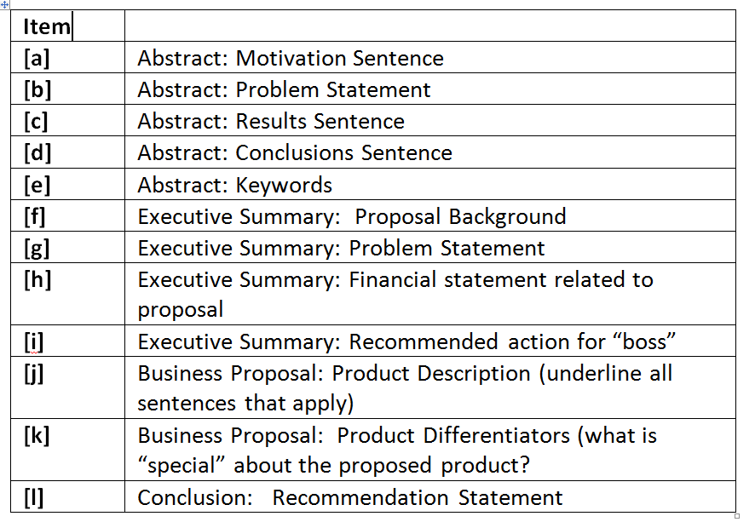
Product Proposal Checklist

Slide 30
Framework for Research Option #2
Area of Research
The “container” is the Analysis Process you choose:
-Compare multiple technologies by measuring their performance in a consistent “test” process (Comparative Analysis)
-Measure a single technology’s ability to perform a previously unachievable “test” (Feasibility Study)
Specific Topic
(Describe Specific Research
Research is a fluid.
It has the form of the container you choose.
Criteria for Analysis
ANALYSIS
Results and Implications
Conclusions &Recommendations

Slide 31
Framework for Research
Area of Research
Example: Deep Learning Applied to Defect Detection for Electronics
Abstract
Exec Summary/Intro
Deep Learning Basics
Deep Learning applied to defect detection
Comparison of DL To current Learning Algorithm
Results and Analysis
Conclusions and Recommendations
Specific Topic
Criteria for Analysis
ANALYSIS
Results and Implications
Conclusions Recommendations

Slide 32
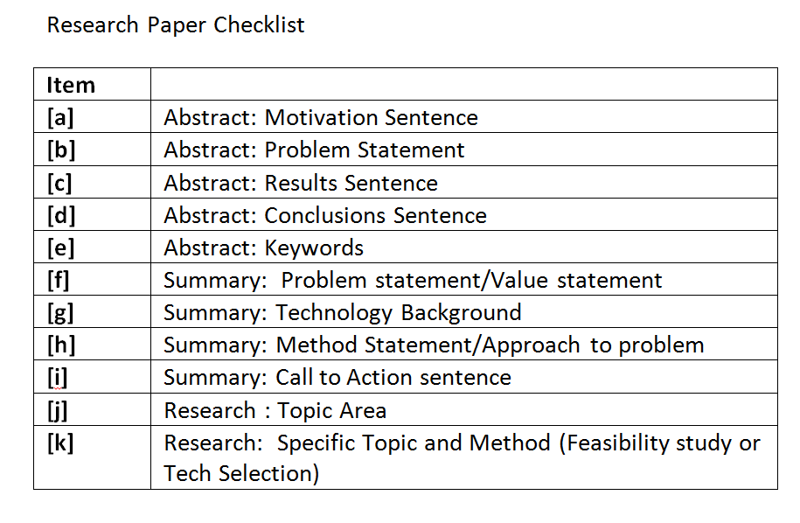
Research Paper Checklist

Slide 33
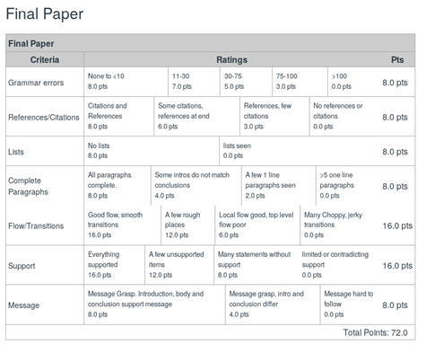

Slide 34
Extra Credit Opportunity

Slide 35
Out of Class Extra Credit
Select an IEEE paper on a topic of interest, read the paper, and write a 400-600 word summary of the paper message, and what can be learned reading the paper. The score shows 0 possible. If you complete this assignment, you will receive up to 8 points on your Out of Class submissions for a well-written paper.
Rules:
1. Underline the topic sentence of each paragraph
2. Address the following in the course of your writeup:
-[a] Write a concise, well-worded Exec Summary for your first paragraph.
-[b]What is the key message of the paper?
-[c] How well does the Abstract represent the paper? Did it entice you to read the whole paper?
BE PREPARED TO PRESENT YOUR WORK IN CLASS
Submit on Canvas
Note: you can download IEEE papers without cost from the library, or when using the campus network.

Slide 36
Resubmit Opportunity on Midterm
Students who wish may revise the midterm paper, and submit it here. To be fair to those who did a good job on the original paper, this revision has a maximum score of 26.
You will get the better of the two scores.
There may be a plagiarism of the original paper submission. I will fix that when the papers are graded.
Please only submit a docx.
Note: The entire paper will be regraded and there is no guarantee of increased paper score over the original, although the odds are in your favor. Instructor notes are provided to help you, but understand that the comments are not comprehensive. Ie, you fix all the noted items, you do not necessarily have a perfect paper.

